Slide 1
Pest detection
Using
Digital image
Processing
Aman Gupta - 1MS17IS015
Ayush Ujjwal - 1MS17IS033
R Anurag Pillai - 1MS17IS145

Slide 2
PROBLEM STATEMENT
OBJECTIVE and OUTCOME
Most of the farmers used the traditional pest management methods which is the regular spray program which sometimes kill useful insects that help in eradicating pests.The old methods trap the insect pests and are brought to the laboratory for counting and identifying manually which are used to estimate the pest density.However this process is tedious and time consuming for a crop technician and also lead to low count accuracy and delays in obtaining accurate counts.
PEST DETECTION USING IMAGE PROCESSING to ensure improved and better farming techniques for farmers. In other words, Image analysis for automated pest detection.

Slide 3
LITERATURE SURVEY
Title | Methods | Drawbacks | Accuracy
Compression based Algorithm | The Segmentation tries to find the pattern of the image and any consistency in the image can be used to compare conceivable segment and coding length of data. | It pre suppose that the optimal segmentation is the one that minimizes the overall conceivable segment and coding length of data. | Size reduction and Customized loading time increases the accuracy.
Corner Response base method | 3 stages involved: Computing corner response in multi scale space and thresholding it to get the candidate region of text. Verifying the candidate region by combining colour and size range feature. Locating the text line using bounding box. | In corner points, in video frame are used to generated connected components but they use just the number of corner points, not CR, to classify text and non text regions. | Has high curvature in the region boundary. A novel text detection and localization method based on corner response.
Edge detection Algorithm | This is well developed field on its own within image processing. Used as a base of another segmentation technique since there is often a shape adjustment in intensity at the region boundaries. | Time consuming and difficult to implement to reach the real time response. The edge identified by edge detection is often disconnected. | SInce Sharp and thin edges are used it leads to greater efficiency in text recognition but difficult to get maximum accuracy.

Slide 4
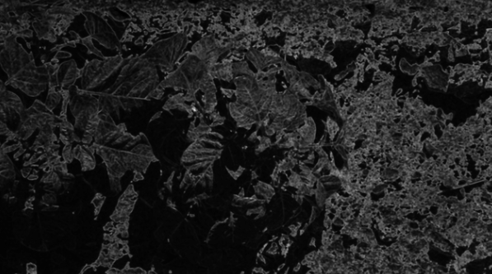
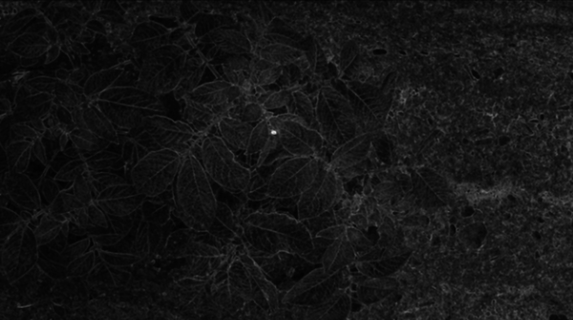
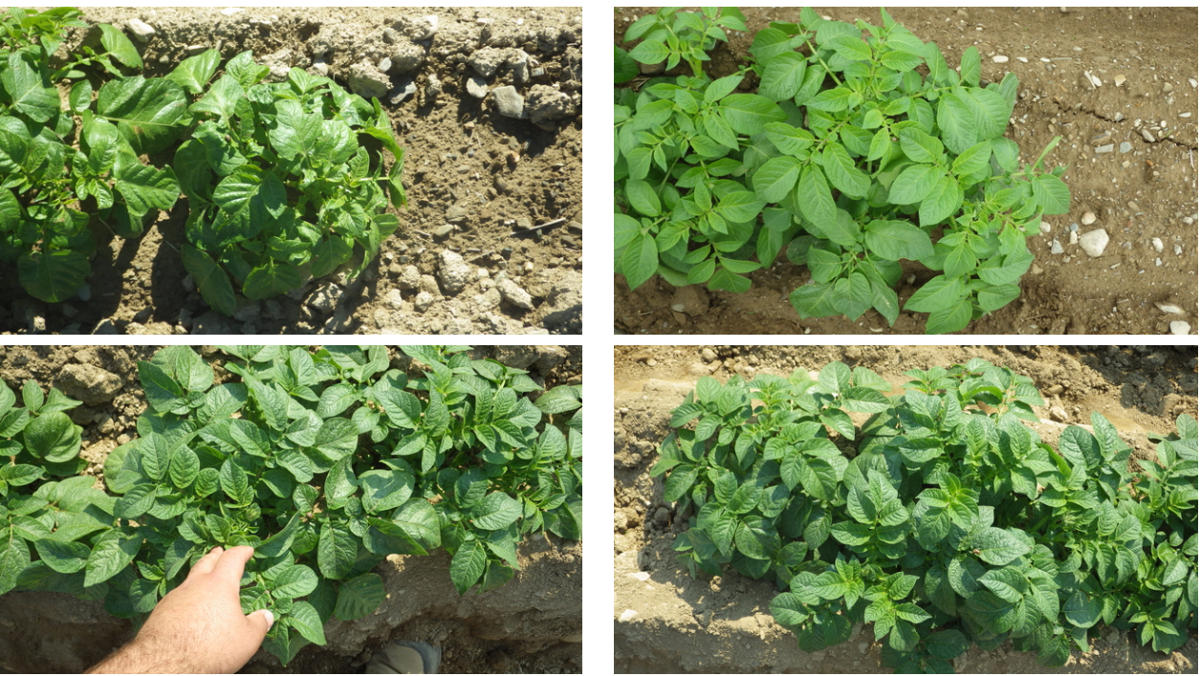
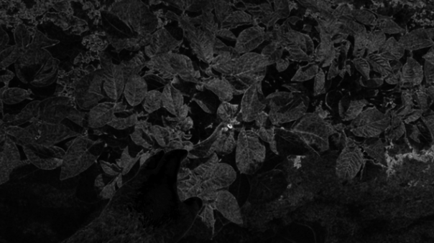
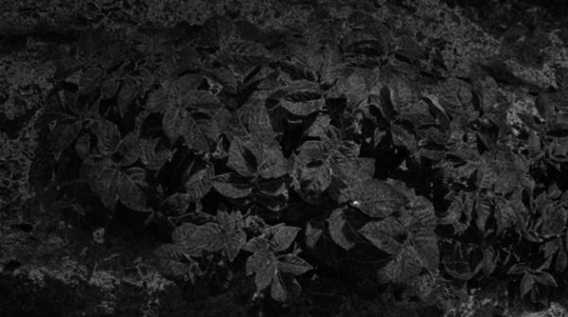
Datasets, Descriptions and Links
Link:
https://www.ipmimages.org/
https://bugguide.net/node/view/15740
https://www.kaggle.com/rhammell/ships-in-satellite-imagery/version/1

Slide 5
Software Details
OpenCV with C++/Python : It is a library which is designed for computational efficiency with a strong focus on real time applications.
Numpy and Scipy : using numpy and Scipy that allows us to manipulate mathematical structures for image, and visualize the data and image attributes.
Jupyter Notebook and Google Colab : As coding and team collaboration environment.
Matplotlib: Matplotlib is a plotting library for the Python programming language and its numerical mathematics extension NumPy

Slide 6
System Design
Image Acquisition
Color Model Conversion
Image Preprocessing
Threshold Masking
Computing Object Boundaries
Morphological Operation
Measurements of labels
Converting RGB to HSV
Gaussian Blurring, Average Filter
For Binary image computation using OTSU and Binary Inverse thresholding.
Opening and Dilation for obtaining proper region of interest
To determine the number of particles
1
2
3
4
5
6

Slide 7
FUTURE ENHANCEMENT
Currently the project depicts what type of pest are affected to leaves but by applying machine learning algorithm we can predict in which season we have most pest and their types
Creating an ecosystem to continuously analyse a field using Cyber Physical Systems and a cloud infrastructure which can be accessed by the end user by the means of a mobile app.
This can be used for:
Continuous Monitoring
Pesticide Usage Management
Pesticide Delivery Scheduling
Strategize Preventive and Avoidance Measures

Slide 8
DRAWBACKS
In terms of Dataset:
Training may need to be repeated to maintain quality. Raters are expensive.
Initial and important challenges are dataset,disease grading(need experienced person).
There can be substantial inter-rater and intra-rater variability (subjectivity).
Particular disease identification.
Region variations in prevalence of particular pest

Slide 9
BIBLIOGRAPHY
https://ieeexplore.ieee.org/document/7873750
https://ieeexplore.ieee.org/document/8229828
https://www.researchgate.net/publication/271305520
https://ieeexplore.ieee.org/document/8365226
https://www.researchgate.net/publication/282119578
https://www.researchgate.net/publication/335395832

Slide 10
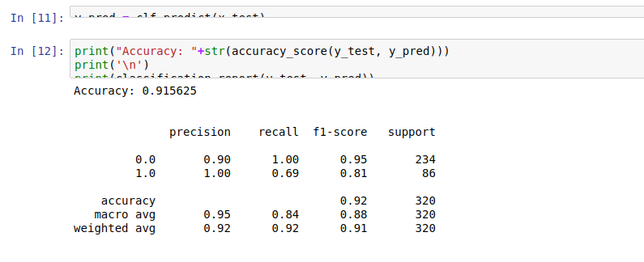
Thank You

Slide 11
Hardware Details
IP Camera module : To capture and transfer the image
Arduino : A microcontroller which will do the following functions: hover, obstacle sensing and path determination
SD Card : to save the captured images and further can be inserted in a mobile or a laptop
Brushless Motors,Propeller Set : Flying the drone
Multi-Copter Frame : A frame for the drone
A laptop/Android mobile : For report analysis

